Slide 1
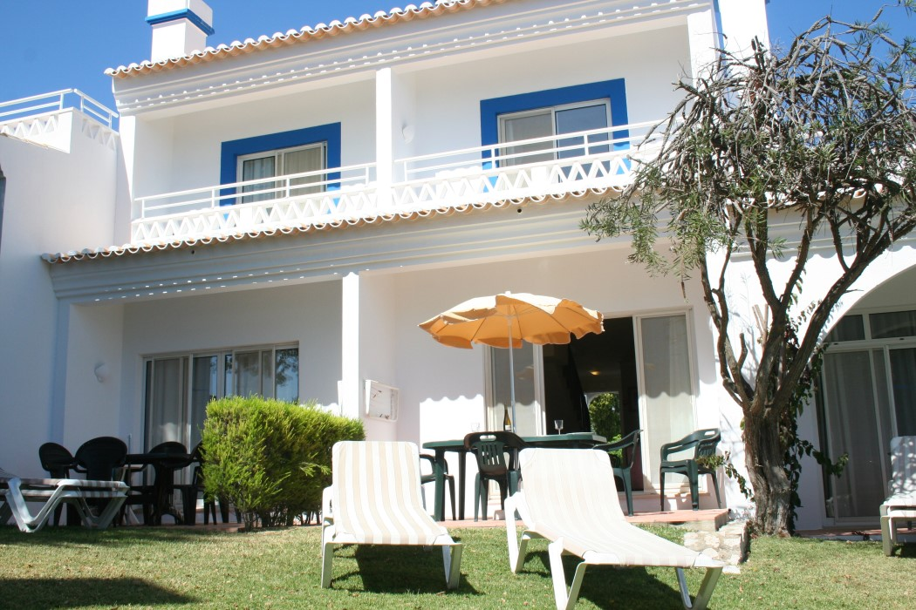
Quarter Share in a two bedroom
Town House located in Pestana Palm Gardens
Ground floor: Reference: CA
Entrance hall.
Step down to lounge / dining area with air conditioning
and patio doors onto terrace and garden area with sea views.
Fully fitted kitchen.
Shower room / Guests toilet.
Stairs from the entrance area leading to the
First floor:
Master bedroom with air conditioning, fitted wardrobes
and patio doors onto small balcony with sea views.
Family Bathroom.
Twin Bedroom with fitted wardrobes, air conditioning
and patio door onto a Juliet balcony.
Fully Furnished.
Please note the period dates rotate each year, for 2021 they are:
Period A: April, August and December
Certificate of Energy Rating: ‘B’
Constructed Area: 90sqm Terraced Area: 7sqm
Annual Condominium 2019: 1142€uros for each share
PRICE: 68,000€ for each share
(Sterling is acceptable)
AMI Licença n.º 7319  APEMIP n.º 3731  Contribuinte n.º 507 757 912
Sala de Vendas  Rocha Brava Apartamentos Turísticos  Apartado 1047  8401 – 908 Carvoeiro LGA  ALGARVE
Tel: (00351) 282 359 533  E-mail: camil6@world.net.pt  www.rochabravaproperty.com

Slide 2
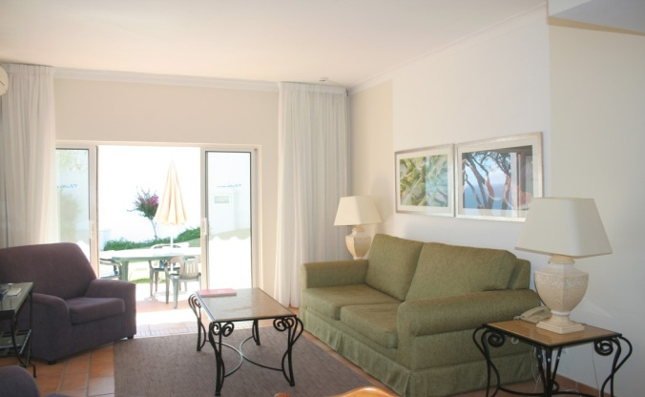
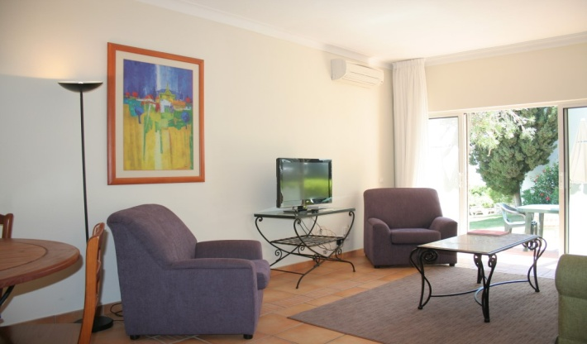
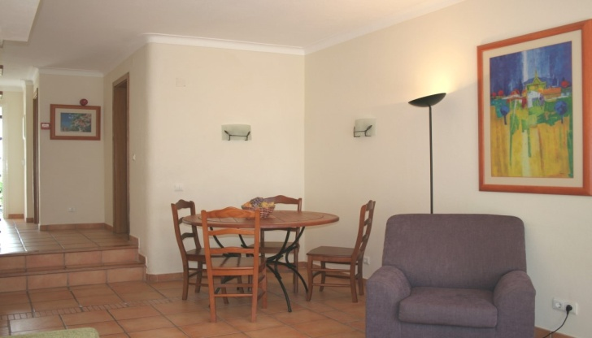
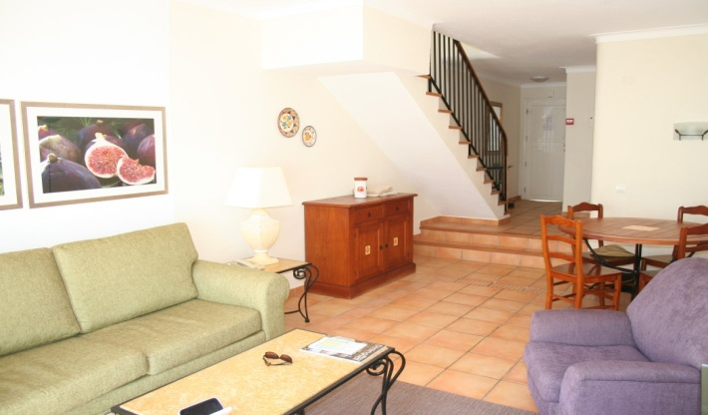
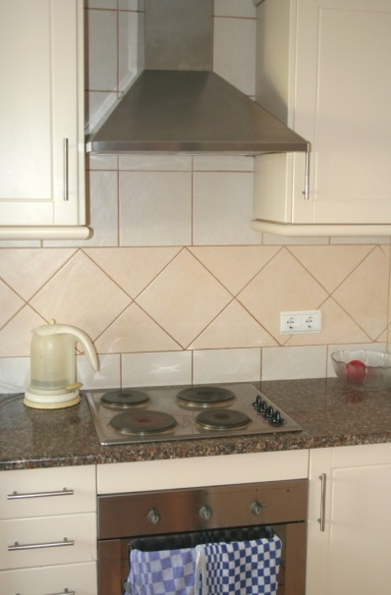
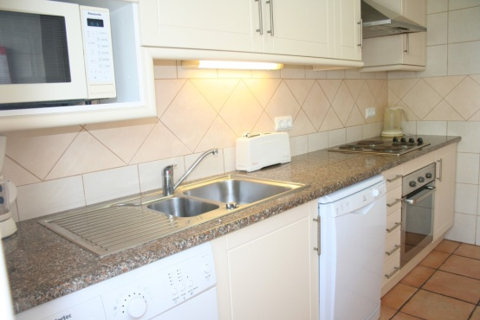
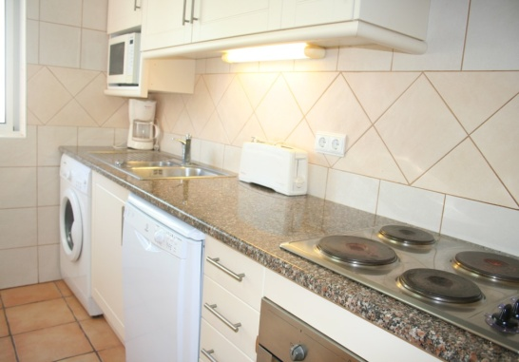
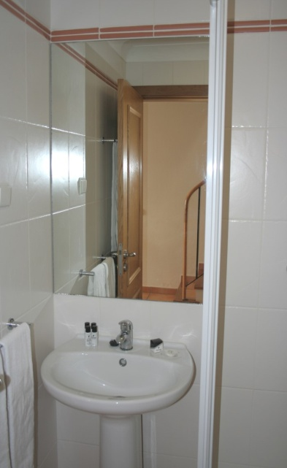
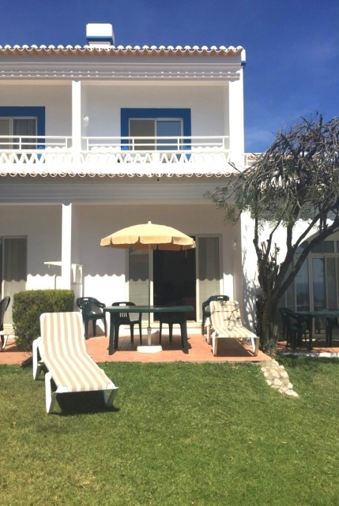
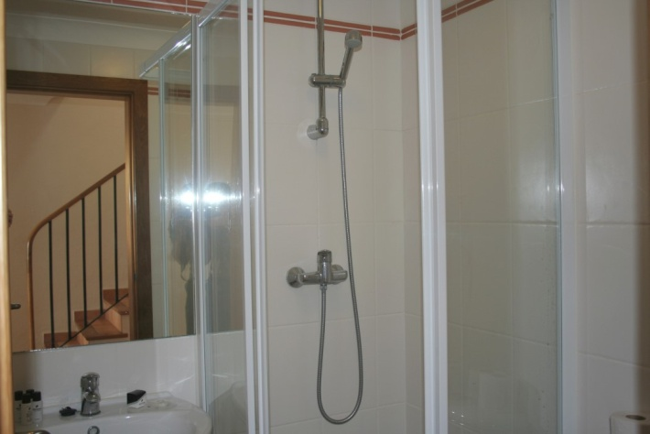
Reference: CA
AMI Licença n.º 7319  APEMIP n.º 3731  Contribuinte n.º 507 757 912
Sala de Vendas  Rocha Brava Apartamentos Turísticos  Apartado 1047  8401 – 908 Carvoeiro LGA  ALGARVE
Tel: (00351) 282 359 533  E-mail: camil@world.net.pt  www.carvoeiroatlantico.com  www.rochabravaproperty.com

Slide 3
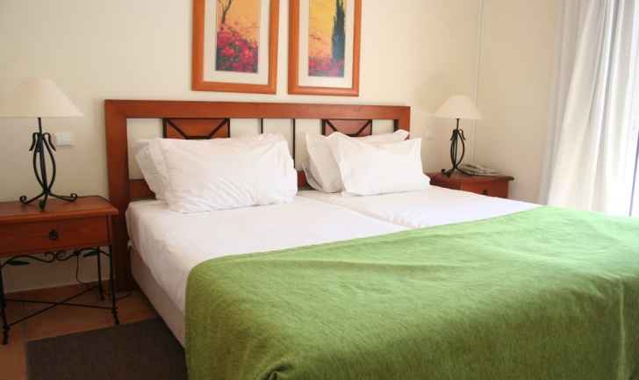
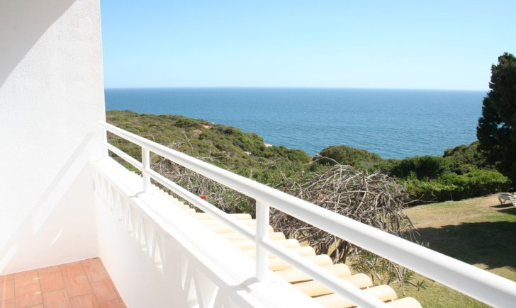
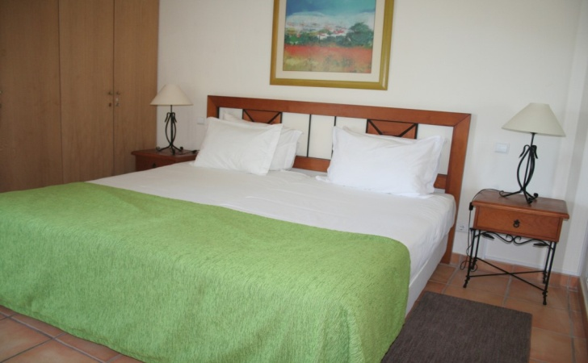
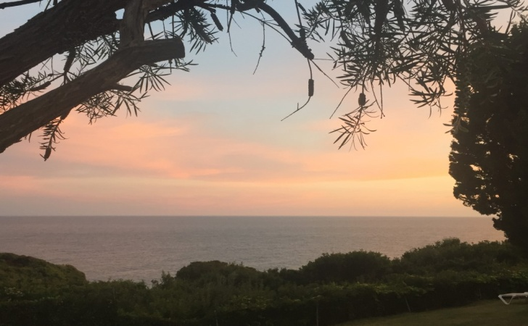
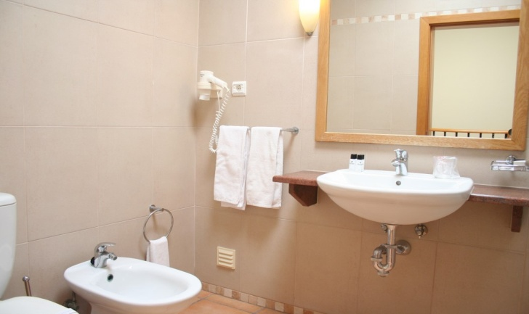
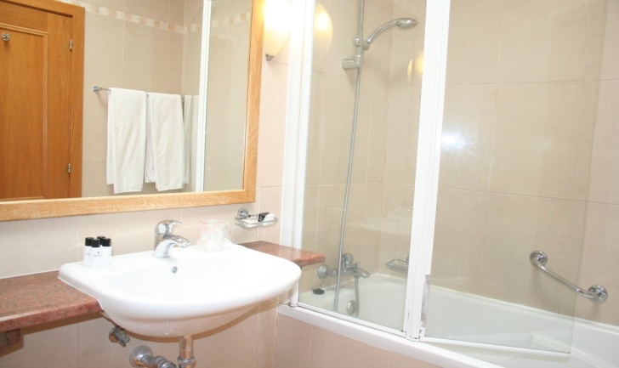
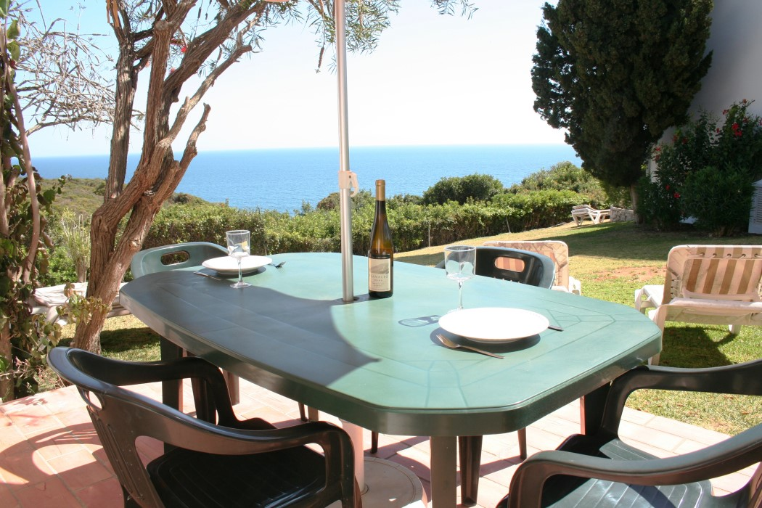
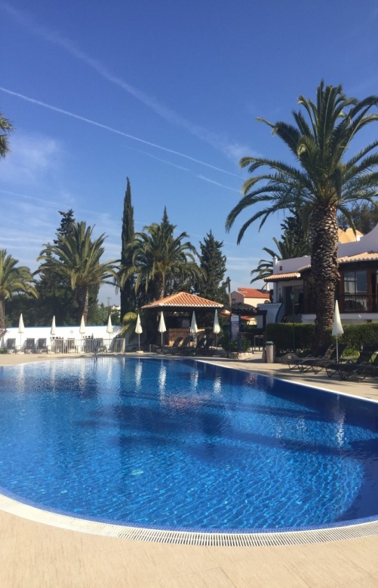
Reference: CA 270 B&C
AMI Licença n.º 7319  APEMIP n.º 3731  Contribuinte n.º 507 757 912
Sala de Vendas  Rocha Brava Apartamentos Turísticos  Apartado 1047  8401 – 908 Carvoeiro LGA  ALGARVE
Tel: (00351) 282 359 533  E-mail: camil6@world.net.pt  www.rochabravaproperty.com

