Slide 1
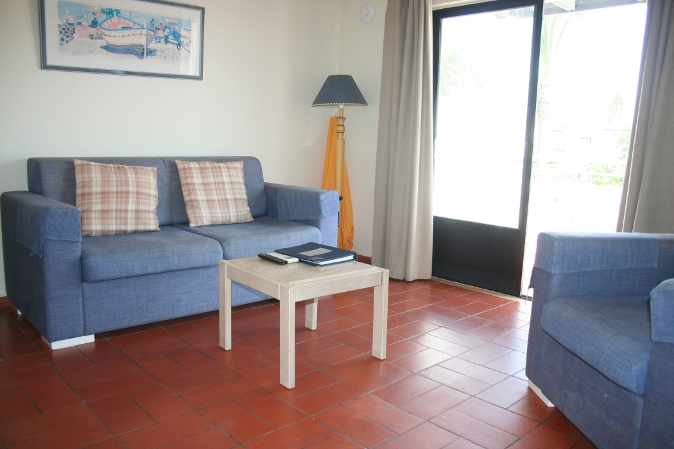
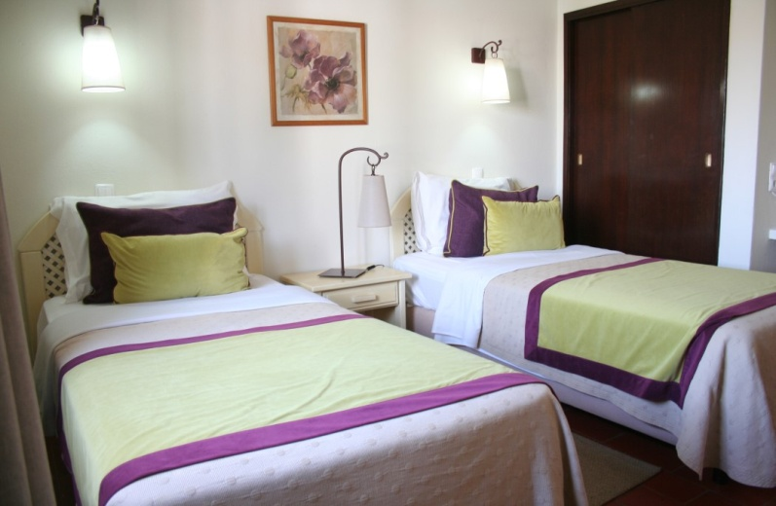
One bedroom first floor apartment located in Country Village area
Reference: OR 331
One bedroom apartment located in Country Village
with a view to the swimming pool.
Lounge / dining area with air conditioning
and patio doors onto large balcony.
Double bedroom with fitted wardrobe and air conditioning.
Refurbished bathroom.
Refurbished Kitchen. Fully furnished.
Certificate of Energy rating: ‘D’
Constructed Area: 65 sqm Terraced Area: 15 sqm
Annual Condominium 2019: 1,545 €uros
PREÇO / PRICE: 140,000€
AMI Licença n.º 7319  APEMIP n.º 3731  Contribuinte n.º 507 757 912
Sala de Vendas  Rocha Brava Apartamentos Turísticos  Apartado 1047  8401 – 908 Carvoeiro LGA  ALGARVE
Tel: (00351) 282 359 533  E-mail: camil6@world.net.pt  www.rochabravaproperty.com

Slide 2
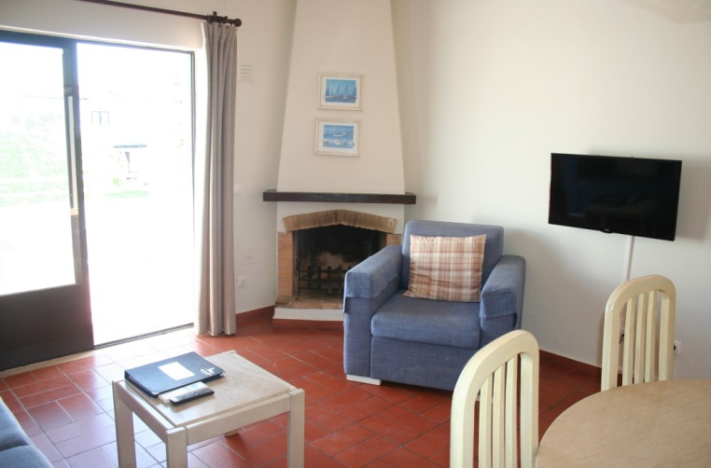
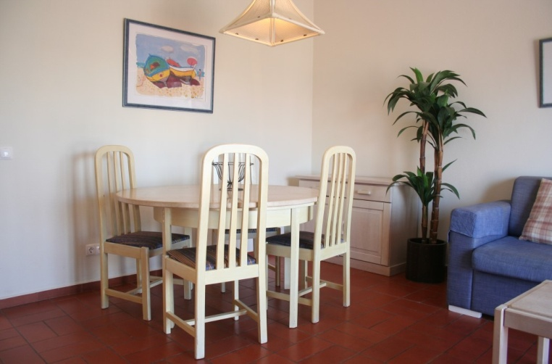
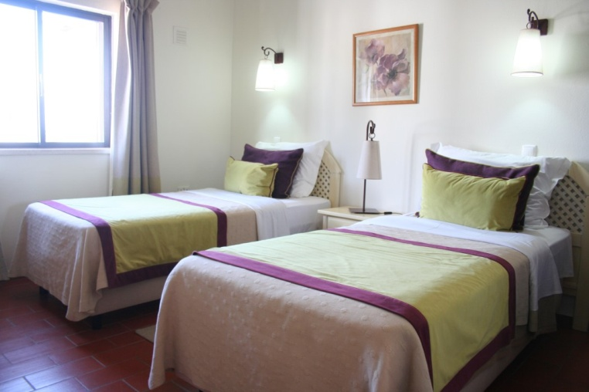
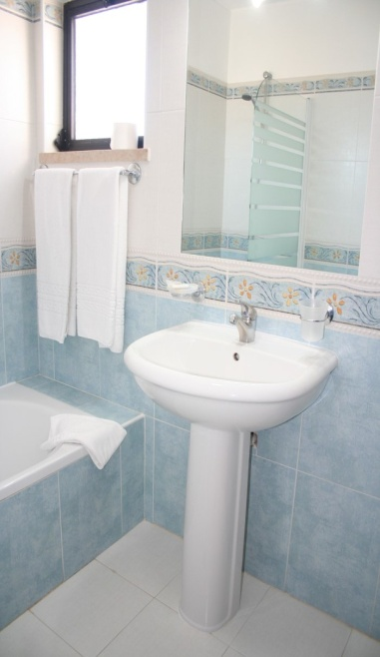
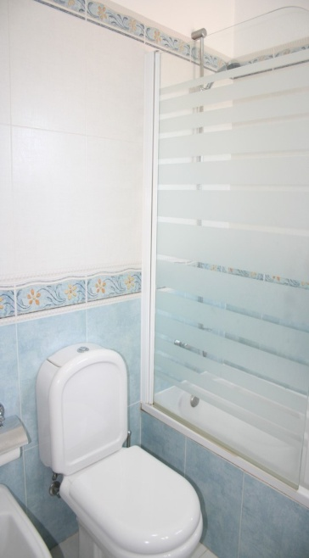
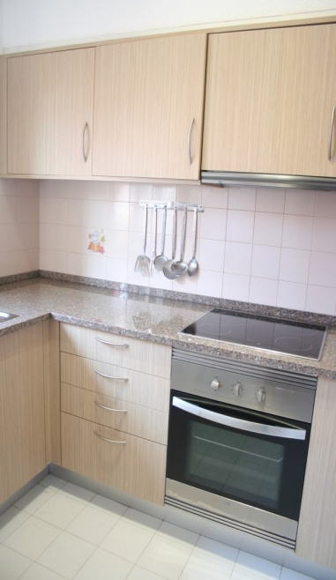
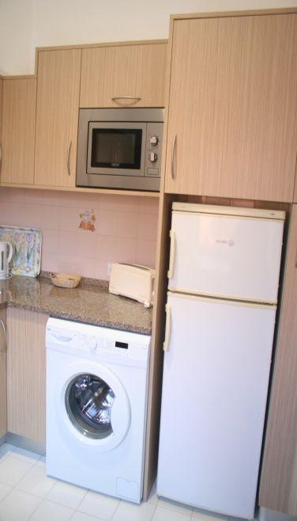
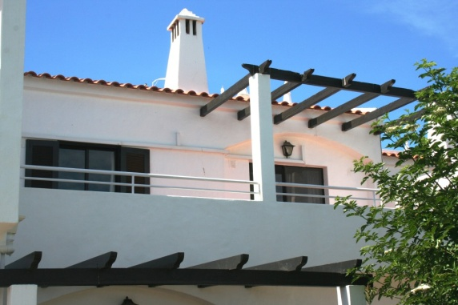
Reference: OR 331
AMI Licença n.º 7319  APEMIP n.º 3731  Contribuinte n.º 507 757 912
Sala de Vendas  Rocha Brava Apartamentos Turísticos  Apartado 1047  8401 – 908 Carvoeiro LGA  ALGARVE
Tel: (00351) 282 359 533  E-mail: camil@world.net.pt  www.rochabravaproperty.com

