Slide 1
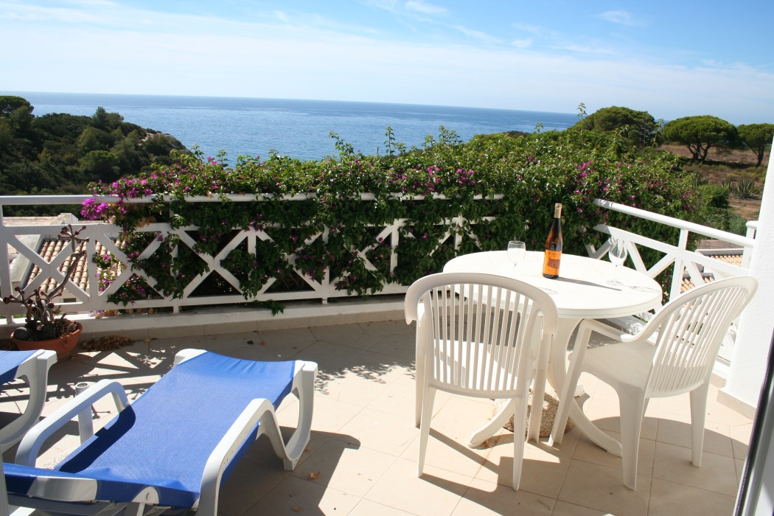
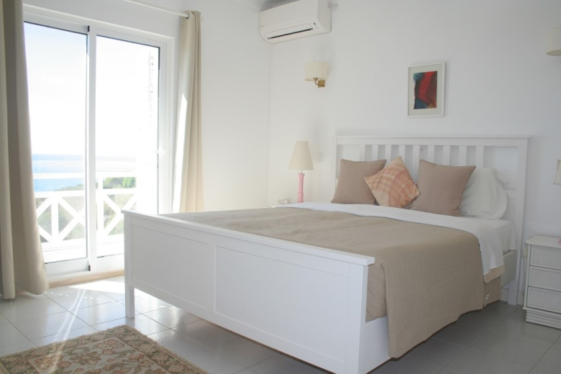
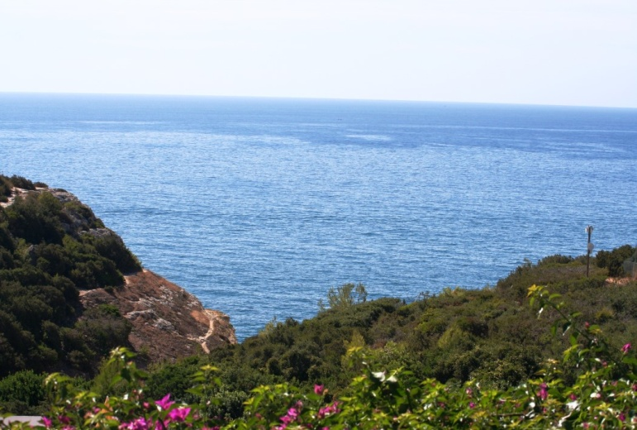
Two bedroom first floor apartment
with good sea views
located on Ocean View
Reference: OR 299
Spacious lounge / dining area with new double glazed patio doors
onto south facing balcony with sea view.
Master bedroom with fitted wardrobe, air conditioning
and new double glazed patio doors
onto a Juliet balcony with sea view.
Ensuite family bathroom.
Bedroom two with fitted wardrobes, air conditioning
and new double glazed windows.
Family shower room.
Fully Fitted Kitchen Fully furnished.
Certificate of Energy rating: ‘X’
Constructed Area: 73 sqm Terraced Area: 15 sqm
Annual Condominium 2018: 2,361 €uros
PREÇO / PRICE: 285,000€
AMI Licença n.º 7319  APEMIP n.º 3731  Contribuinte n.º 507 757 912
Sala de Vendas  Rocha Brava Apartamentos Turísticos  Apartado 1047  8401 – 908 Carvoeiro LGA  ALGARVE
Tel: (00351) 282 359 533  E-mail: camil6@world.net.pt  www.rochabravaproperty.com

Slide 2
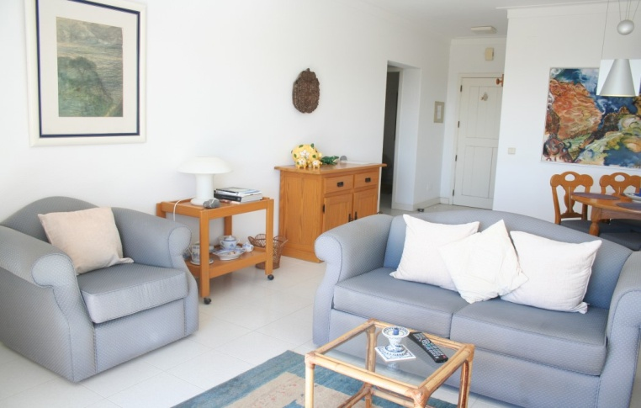
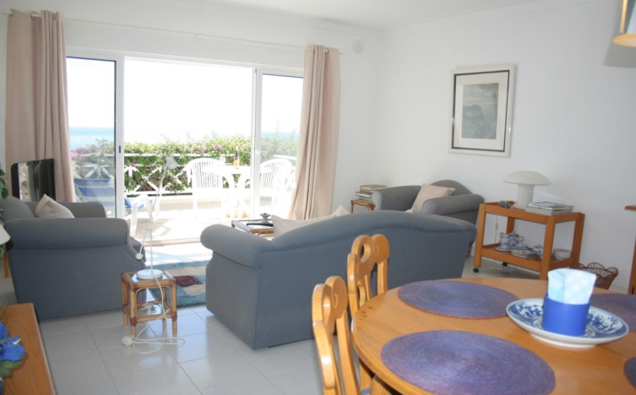
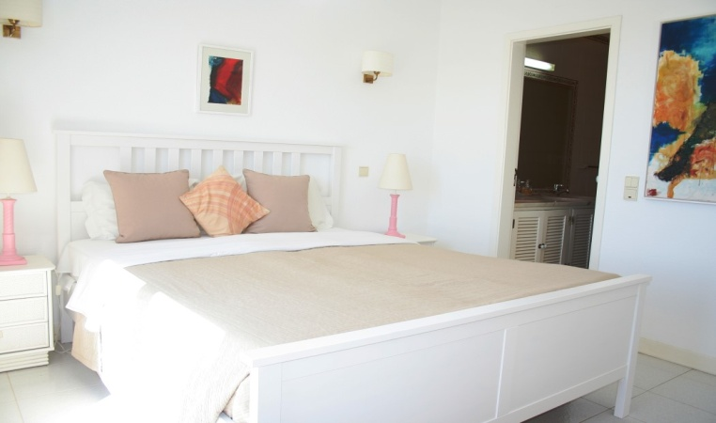
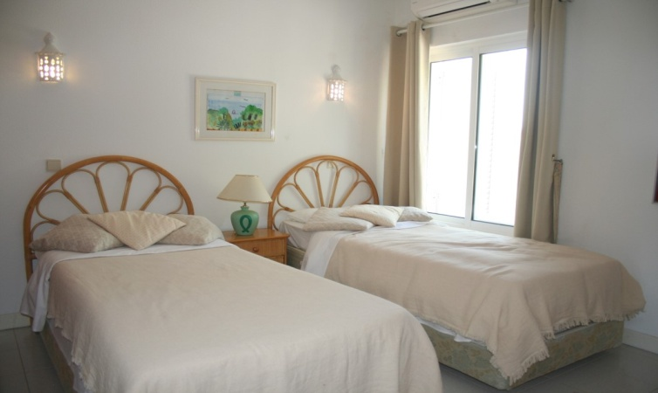
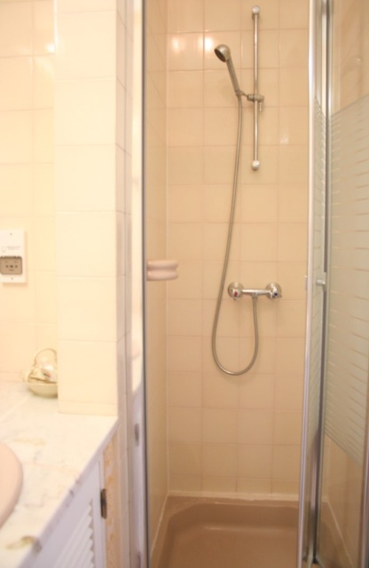
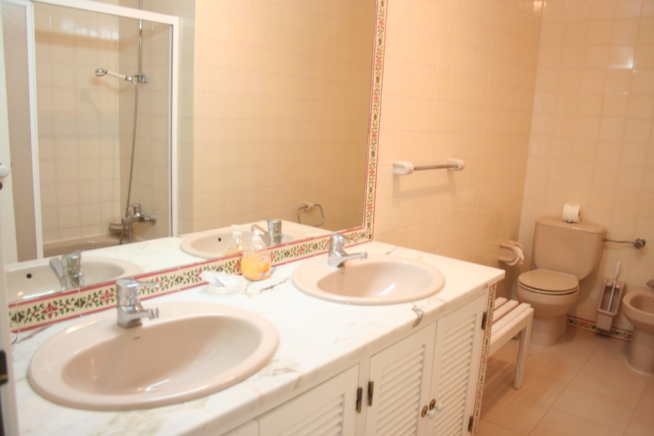
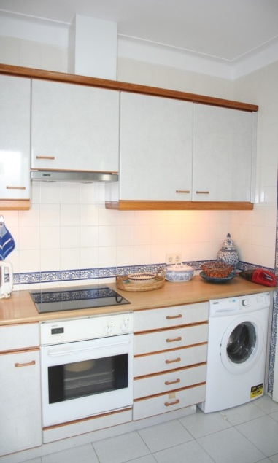
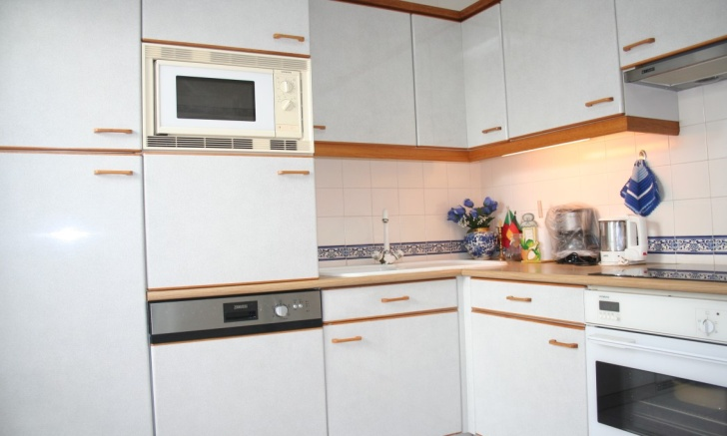
Reference: OR 299
AMI Licença n.º 7319  APEMIP n.º 3731  Contribuinte n.º 507 757 912
Sala de Vendas  Rocha Brava Apartamentos Turísticos  Apartado 1047  8401 – 908 Carvoeiro LGA  ALGARVE
Tel: (00351) 282 359 533  E-mail: camil@world.net.pt  www.rochabravaproperty.com

